Slide 1
THORACIC DUCT
BY
DR. OGWUCHE, ELIJAH
(BSc. MSc. MB,BS)
LAGOS STATE UNIVERSITY COLLEGE OF MEDICINE (LASUCOM), IKEJA.

Slide 2
OUTLINE
INTRODUCTION
ORIGIN
COURSE
TERMINATION
TRIBUTARIES
VARIATIONS
FUNCTIONS
APPLIED ANATOMY
REFERENCES

Slide 3
INTRODUCTION
The thoracic duct, also called Van Hoorne’s canal, is the largest lymphatic vessel in the human body.
About 40cm long in an adult, approximately 5mm wide at the abdominal origin
Drains about 75% of the lymph from the entire body
It receives all the lymphatic vessels inferior to the diaphragm and left side of the body above the diaphragm
Does not receive lymph from; right upper limb, right breast, right lung, right side of the head and neck which are drained by the right lymphatic duct

Slide 4
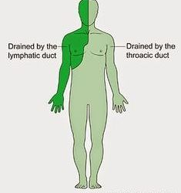
ILLUSTRATION

Slide 5
ORIGIN
It commences at the Cysterna chyli, on level with the body of the twelfth thoracic vertebra (T12).
The Cysterna chyli is an abdominal confluence of the right and left lumbar lymph trunks, as well as the left and right intestinal lymph trunks between T12 and L2

Slide 6
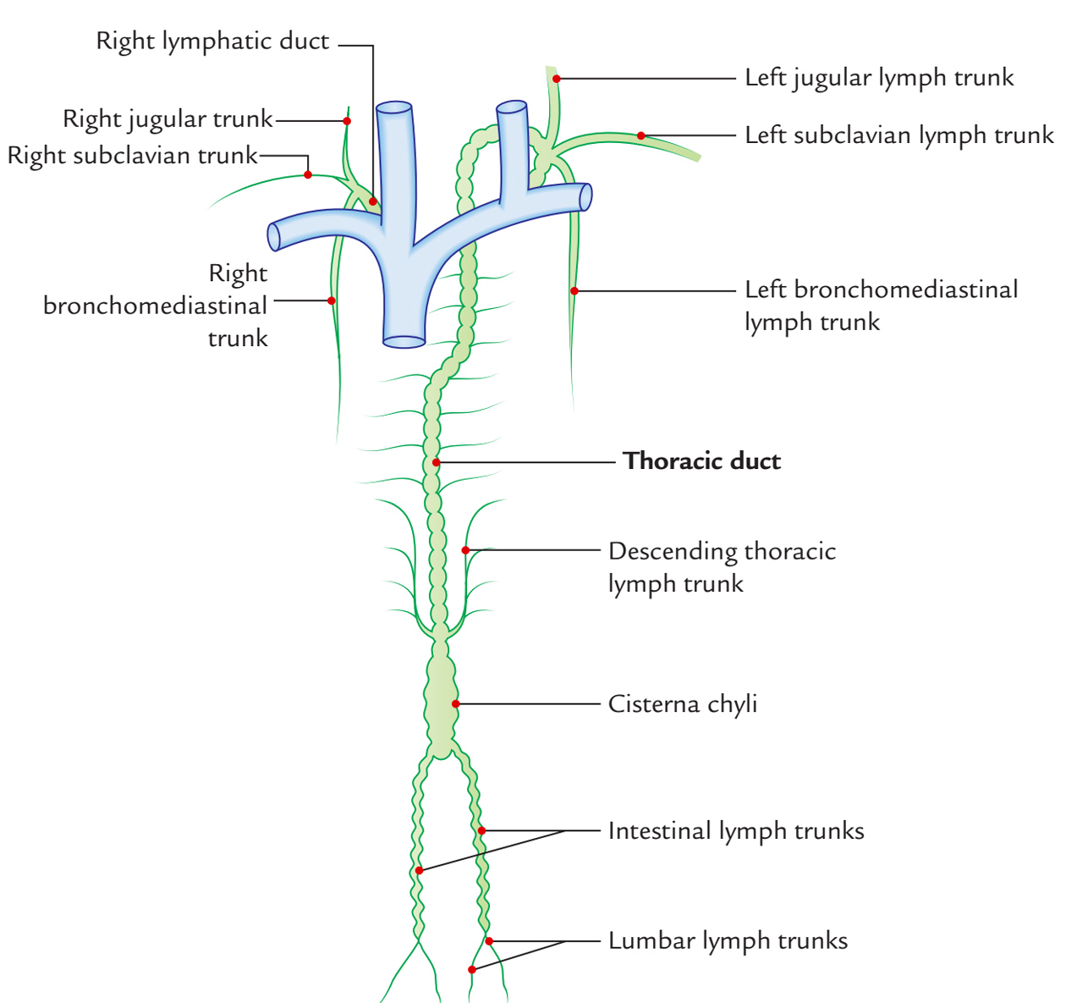
DIAGRAM

Slide 7
COURSE
The thoracic duct passes superiorly from the cisterna chyli through the aortic hiatus in the diaphragm.
It ascends in the posterior mediastinum between the thoracic aorta and azygos vein
It then reaches the right side of the esophagus and passes superiorly anterior to the origin of the right posterior intercostal arteries
At the level of the 5th thoracic vertebra (T5), it crosses to the left, posterior to the superior mediastinum
From this point, it ascends behind the aortic arch and the left subclavian artery, then to its final destination (termination)

Slide 8
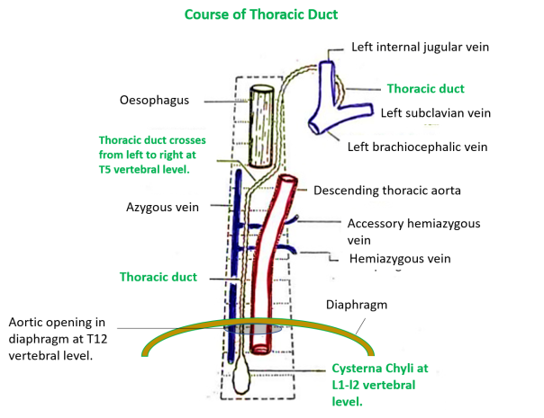
DIAGRAM

Slide 9
TERMINATION
The thoracic duct divides into two or three separate branches, all of which open separately into the venous system near the union of the left internal jugular vein (IJV) and the subclavian vein, at the venous angle called Pirogoff’s angle

Slide 10
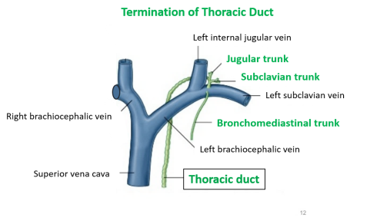
DIAGRAM

Slide 11
TRIBUTARIES
It receive lymph from;
- the posterior mediastinal lymph nodes
- right and left descending thoracic lymph trunks
- upper intercostal lymph trunks (1-5 intercostal spaces)
Others include;
- mediastinal lymph trunks
- left jugular trunk
- left bronchomedistinal trunk
- left subclavian trunk

Slide 12
VARIATIONS
The thoracic duct in some individuals, occasionally divides into a right and left duct, with the left entering the venous system as normal and the right draining into the right subclavian vein
It may also drain into the left IJV, or into the left brachiocephalic vein

Slide 13
APPLIED ANATOMY
Chylothorax ; rupture of the thoracic duct causes leakage into the pleural cavity
Virchow’s node; palpably enlarged lymph node in the left supraclaviclar area that drains the lymph from the (Positive Troisier’s sign; one of the earliest sign of intra-abdominal malignancy),
Thoracic duct fistula; occours following surgery and can lead to protein, electrolytes and fluid inbalance

Slide 14
REFERENCES
Frank H.Netter MD: Atlas of Human Anatomy, 5th Edition, Elsevier Saunders.
Chummy S.Sinnatamby: Last’s Anatomy Regional and Applied, 12th Edition, Churchill Livingstone Elsevier.
Richard L. Drake, A. Wayne Vogl, Adam. W.M. Mitchell: Gray’s Anatomy for Students, 2nd Edition, Churchill Livingstone Elsevier.
Ted L Tewfik, MD: Thoracic duct anatomy. WebMD LLC (accessed 18/01/2016).
Gray, Henry: Anatomy of the human body. Philadelphia: Lea & Febiger, 1918; Bartleby.com, 2000. (accessed 18/01/2016).
Knipe H, MD: Thoracic duct. Radiopaedia.org (accessed 18/01/2016).
Riquet M. et al: Thoracic duct tributaries from intrathoracic organs. PubMed.gov (accessed 18/01/2016).

Slide 15
THANK YOU FOR LISTENING

